Slide 1
Therefore go and make disciples of all nations… Matthew 28:19 (NIV)
Western Wisconsin District Mission Board

Slide 2
1 Monroe, WI- Mt. Olive
2 Mt. Horeb, WI – Good News
3 Richland Center, WI
4 Roscoe, IL - Amazing Grace
5 Stevens Point – The Word
6 Wausau, WI
7 Adams, WI – St. Paul’s
8 Fitchburg, WI
9 Horicon, WI
6 Rural Wausau, WI

Slide 3
Sanctify them by the truth; your word is truth. John 17:17 (NIV)

Slide 5
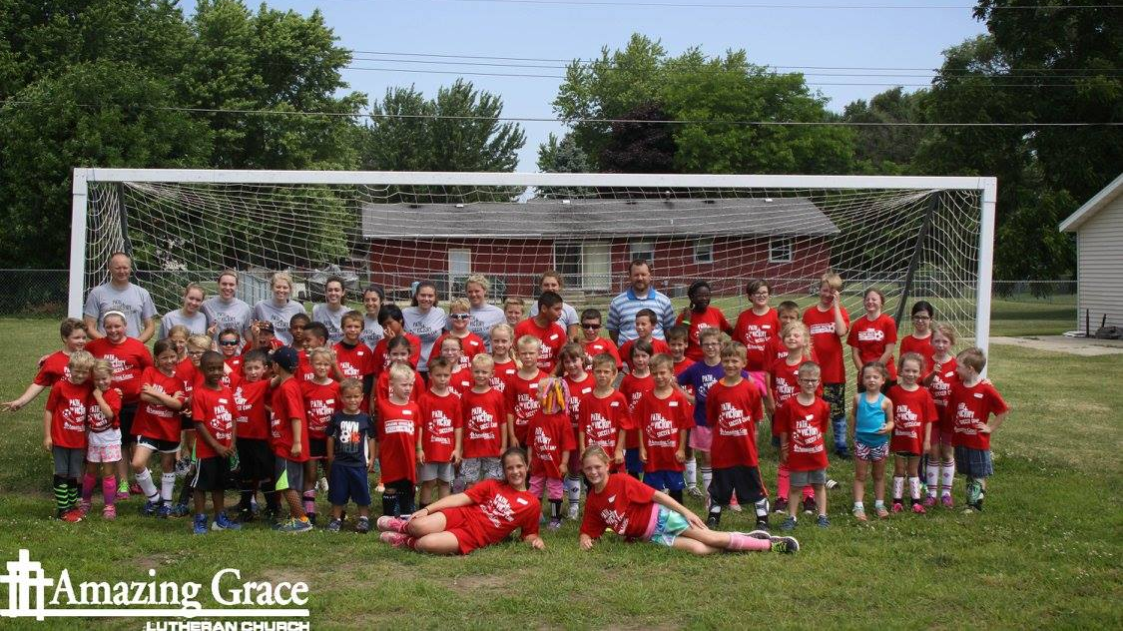

Slide 6
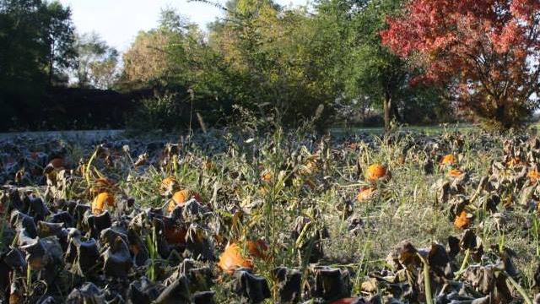

Slide 7
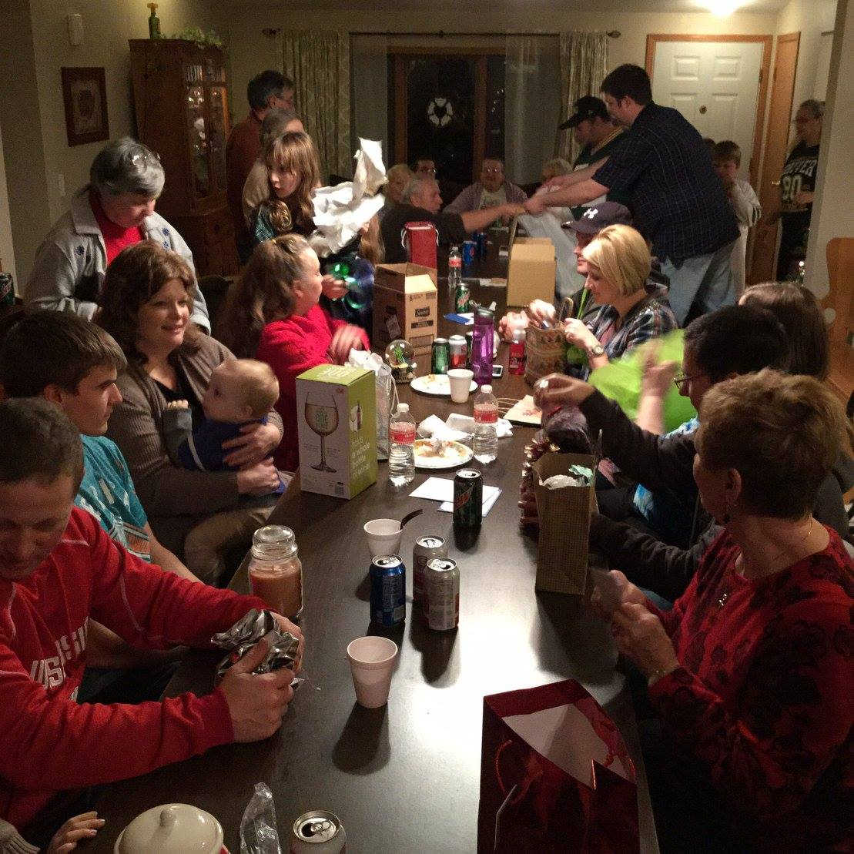

Slide 8
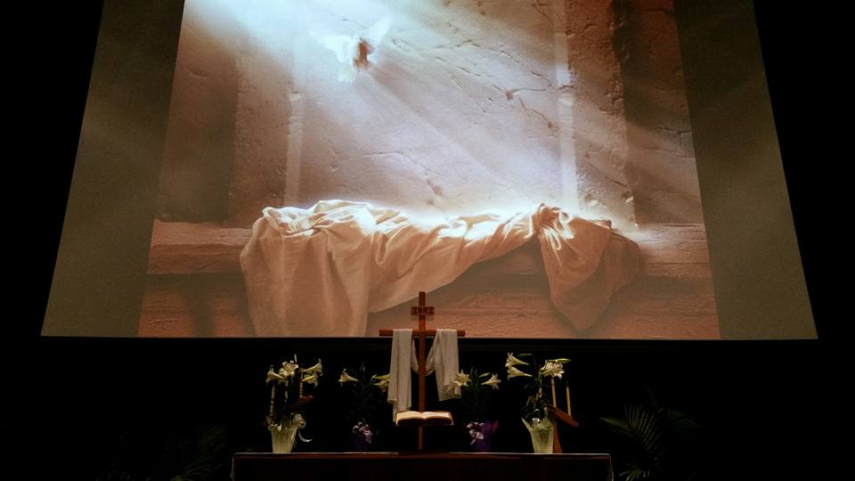

Slide 9
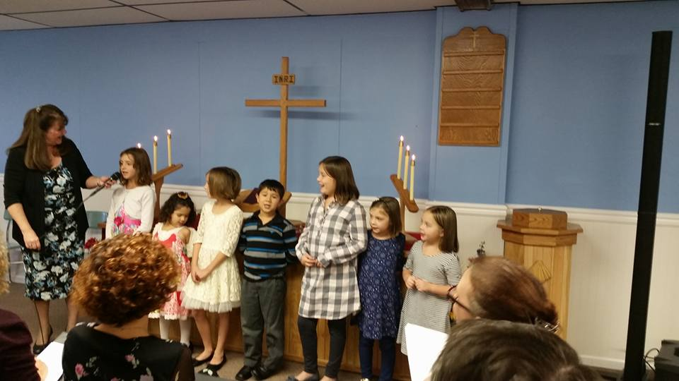

Slide 11
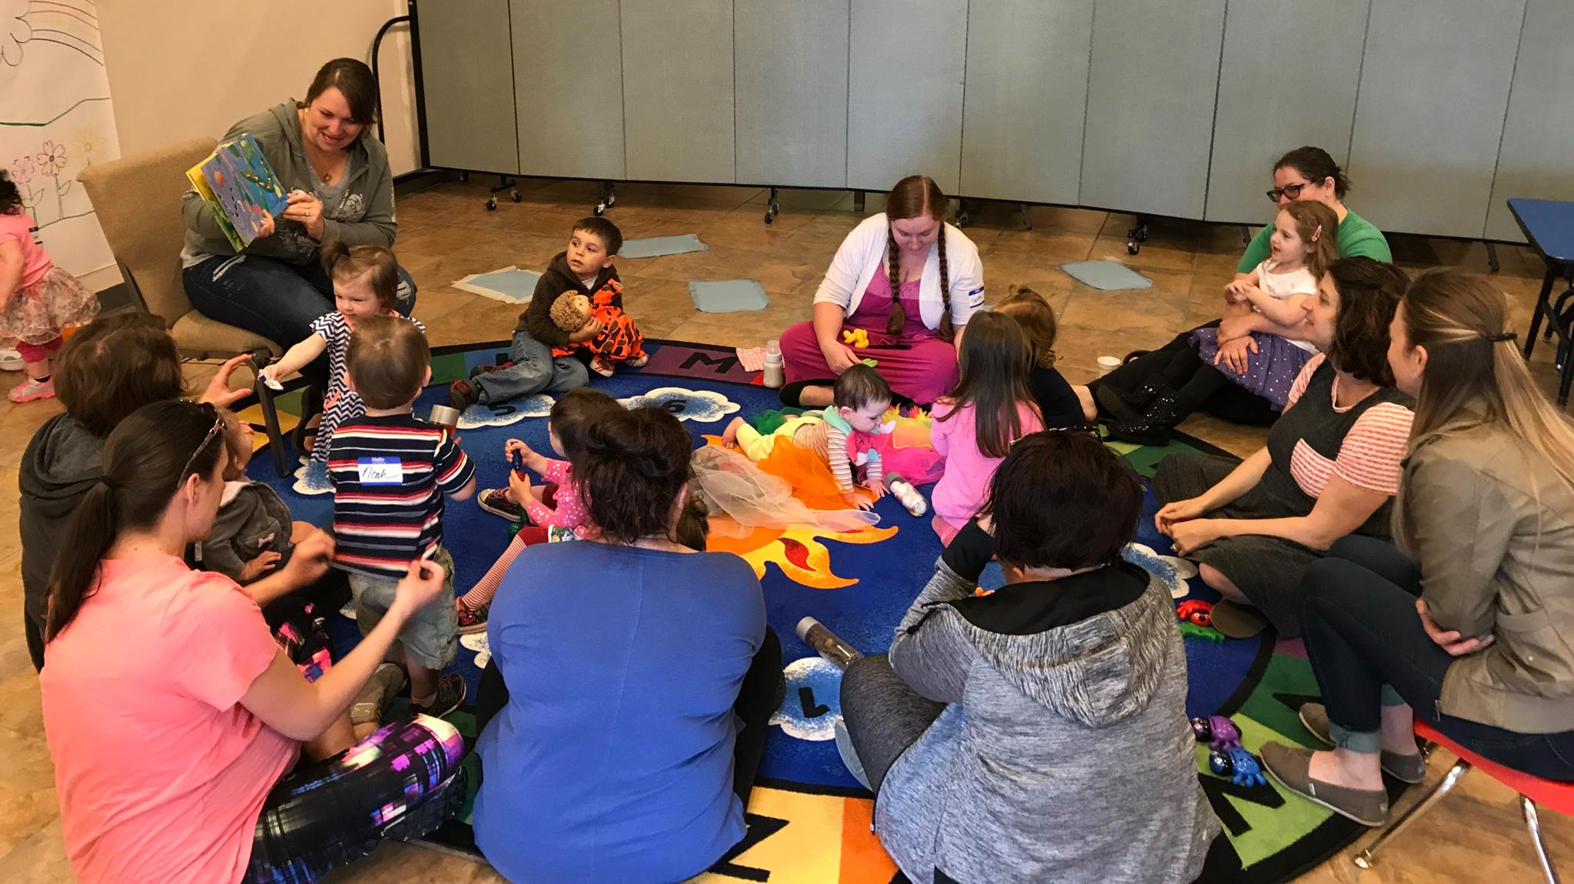

Slide 12
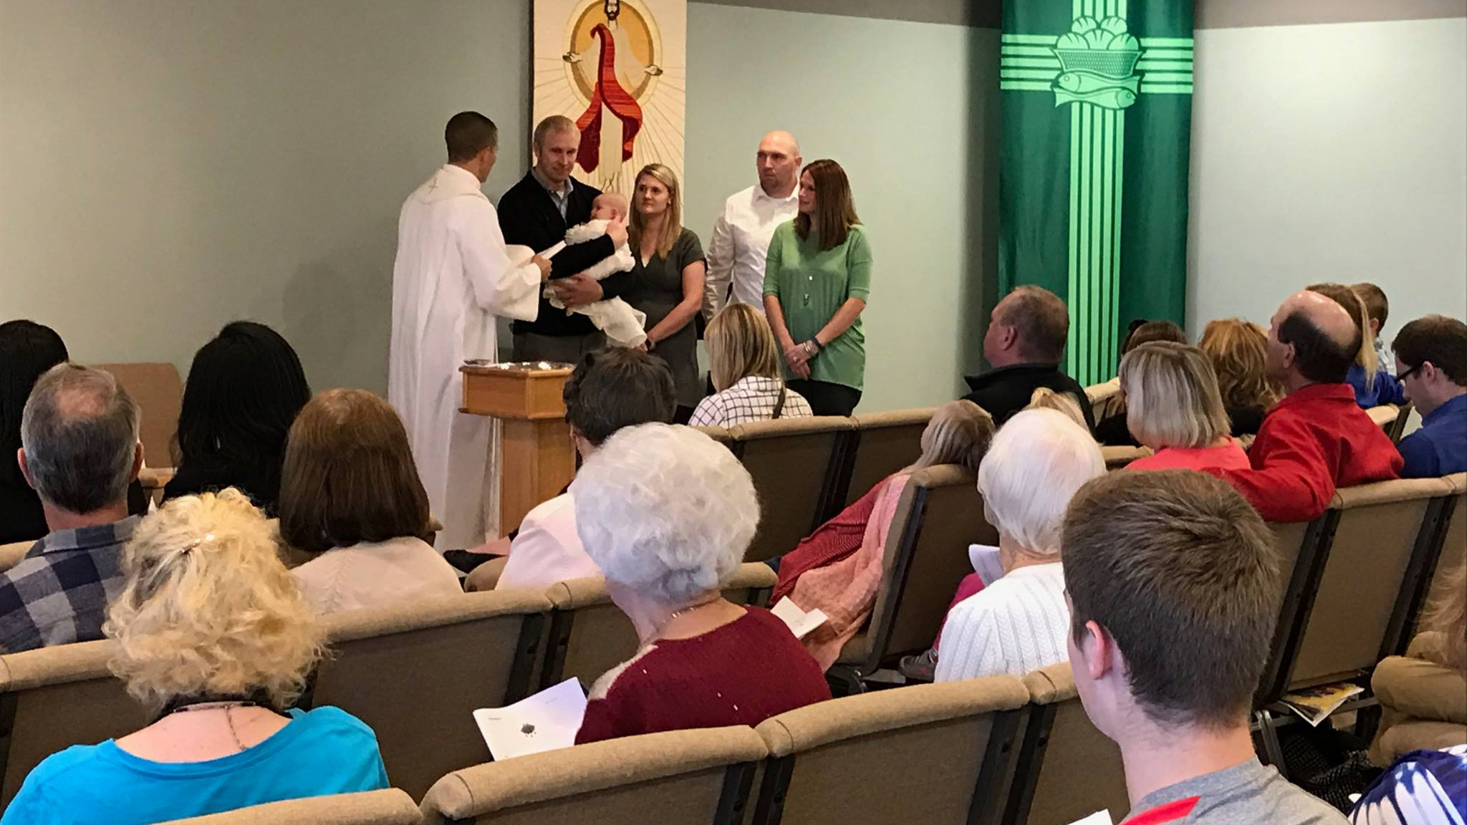

Slide 13
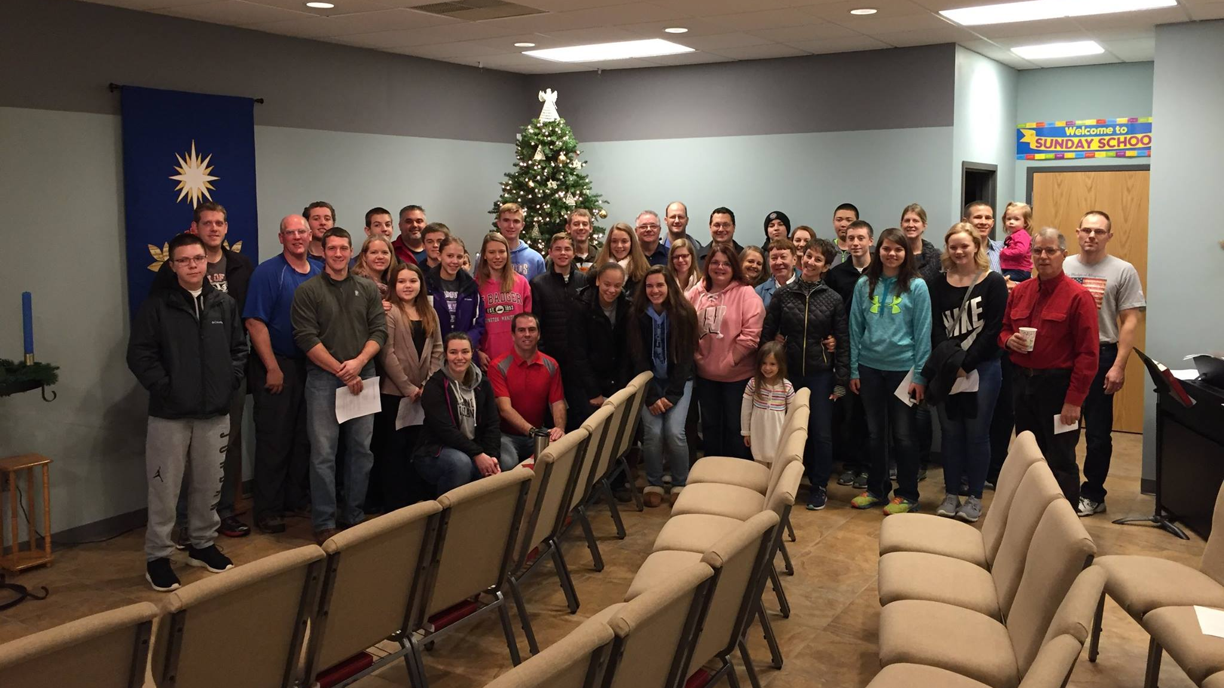

Slide 14
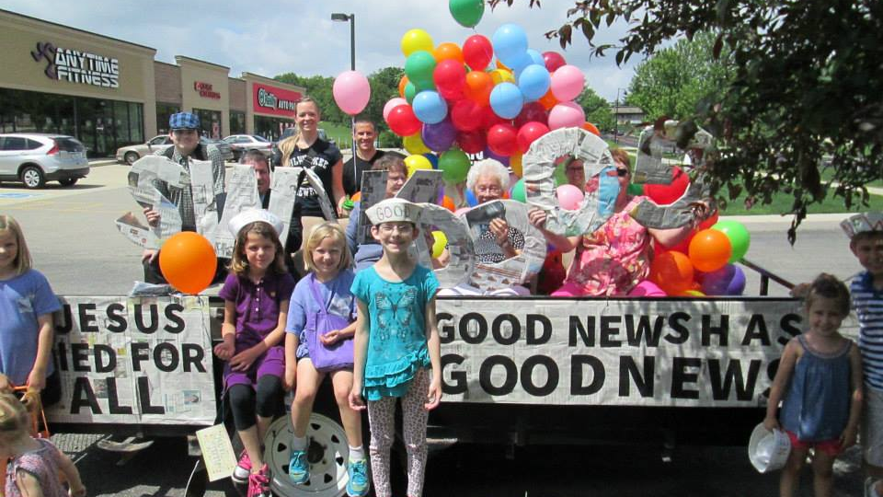

Slide 17
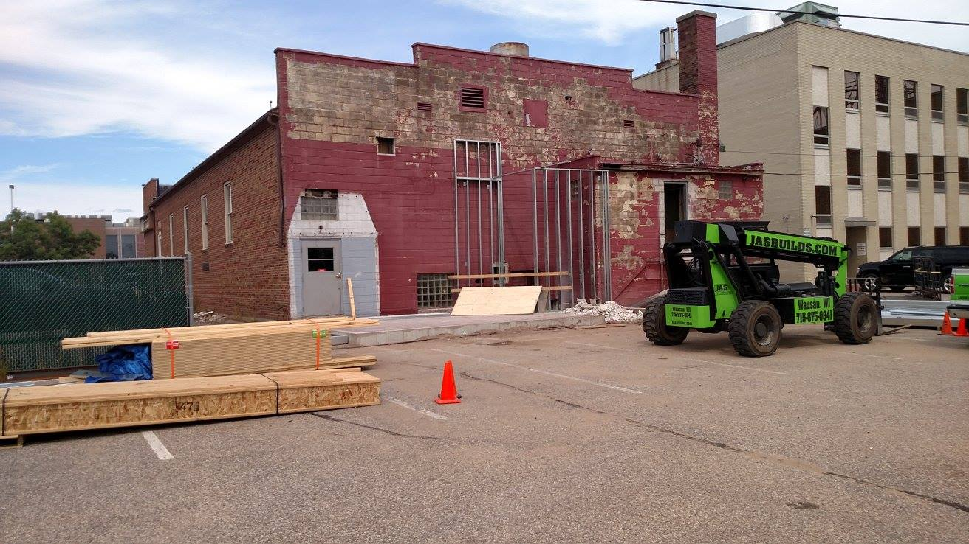

Slide 18
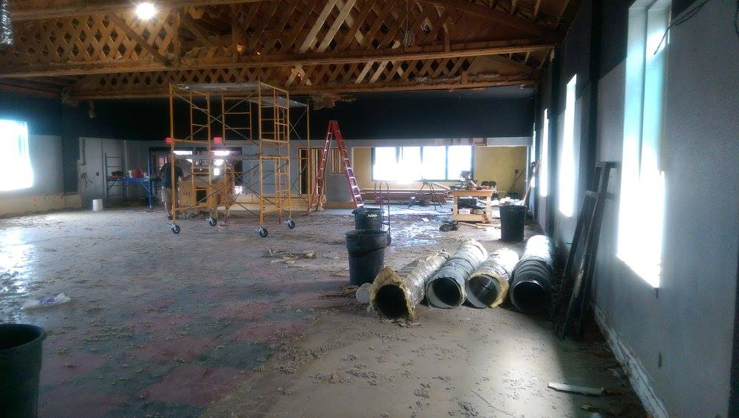

Slide 19
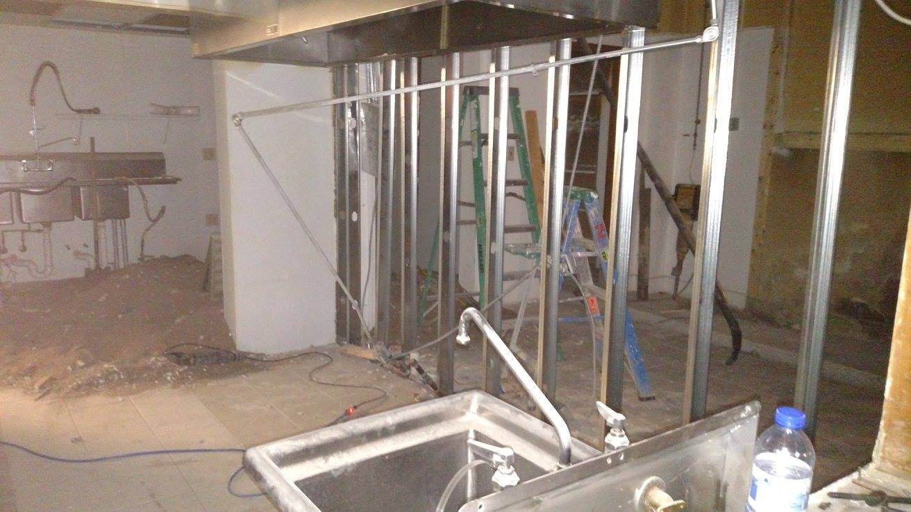

Slide 20
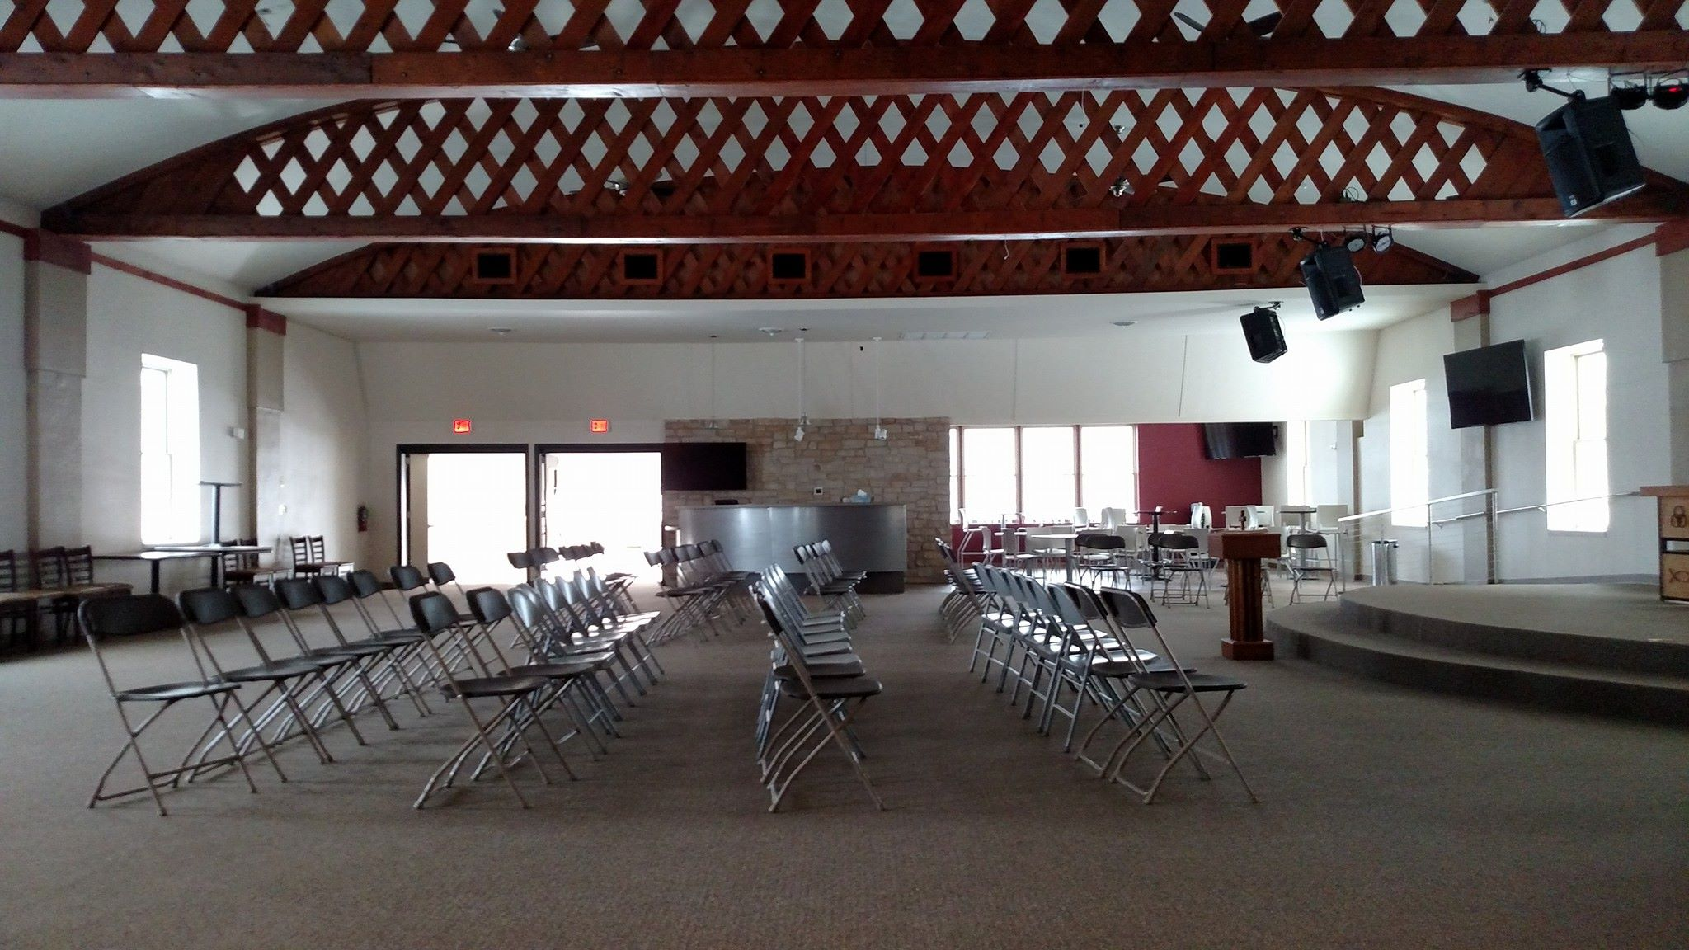

Slide 21
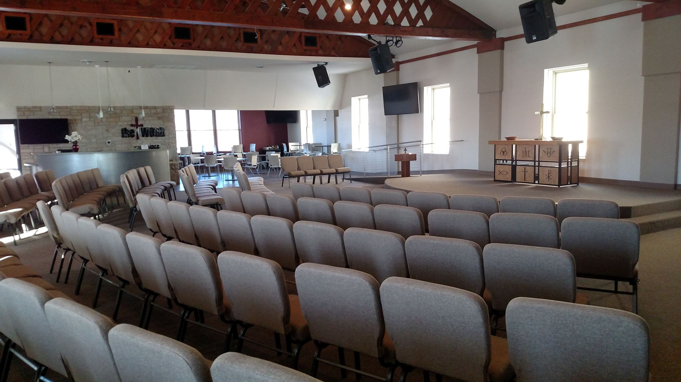

Slide 22
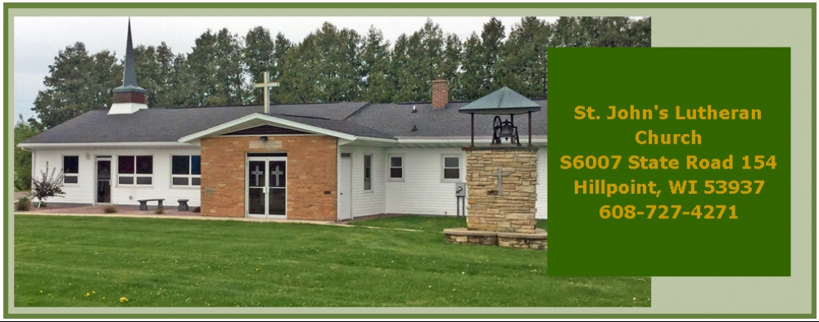
Bible Breakfast Hour We are hosting a monthly Bible class at the Country Kitchen in Richland Center at 9:00 AM on the 2nd Saturday of each month. You are invited to join in the buffet breakfast (discounted cost of $5) as we study A Shepherd's Look at Psalm 23.
Richland Center Outreach

Slide 23
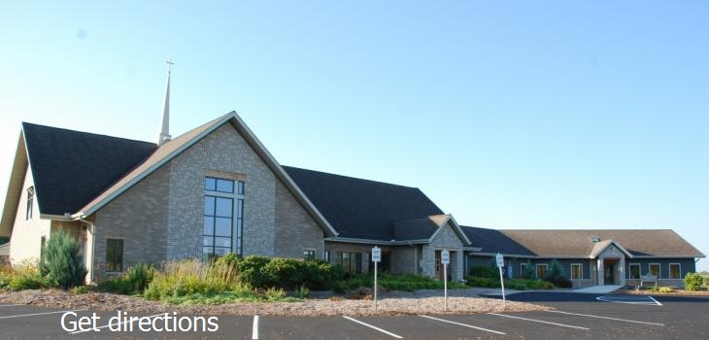

Slide 24
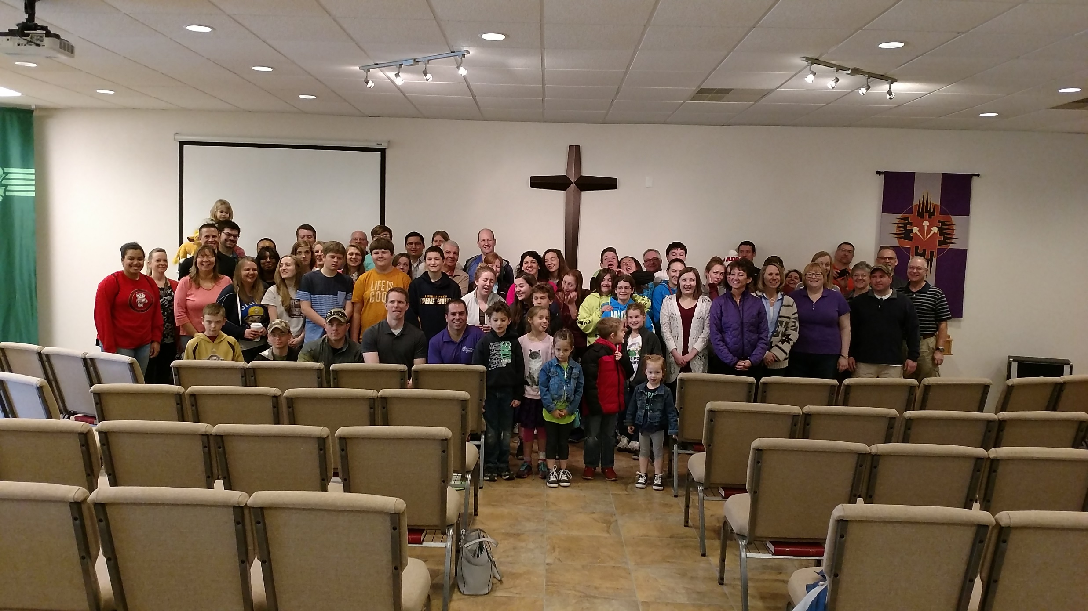

Slide 25
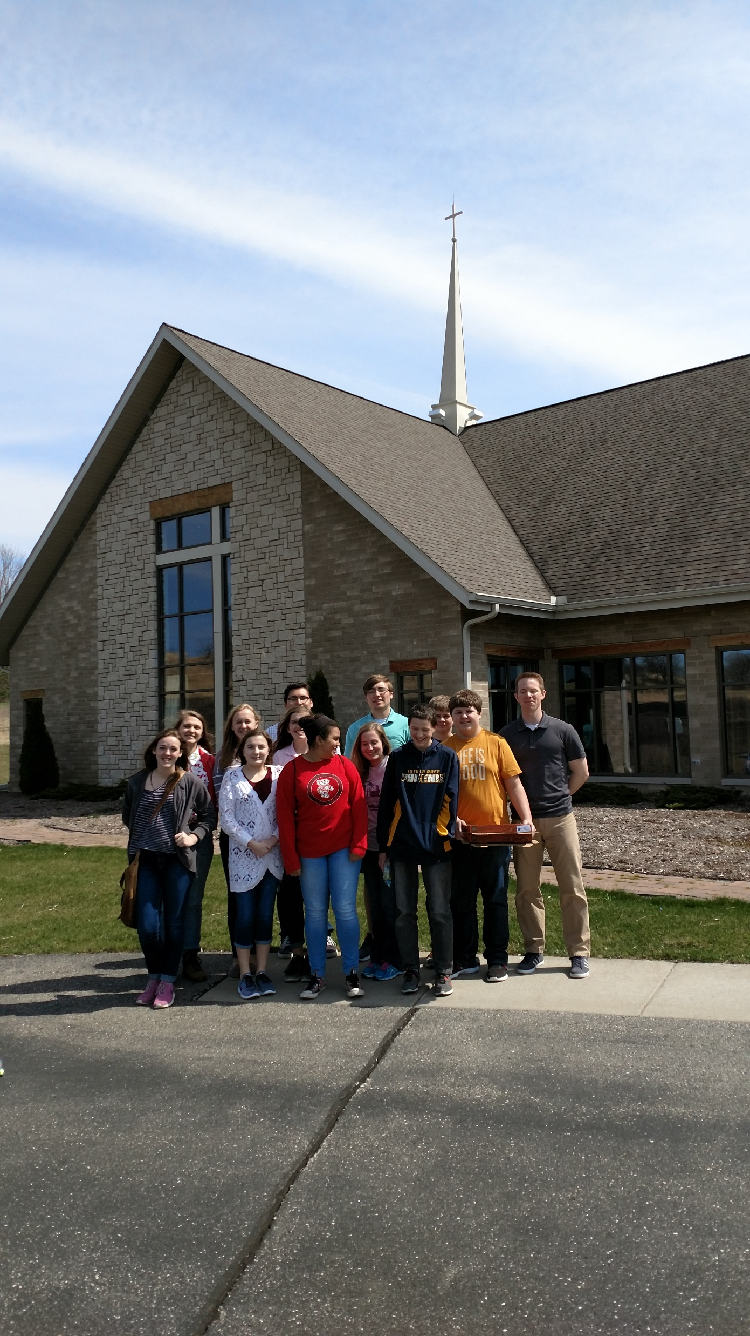

Slide 26
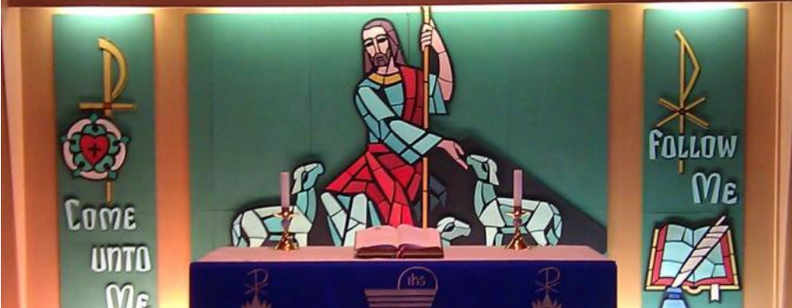

Slide 27
1 Monroe, WI- Mt. Olive
2 Mt. Horeb, WI – Good News
3 Richland Center, WI
4 Roscoe, IL - Amazing Grace
5 Stevens Point – The Word
6 Wausau, WI
7 Adams, WI – St. Paul’s
8 Fitchburg, WI
9 Horicon, WI
6 Rural Wausau, WI

Slide 28
Therefore go and make disciples of all nations… Matthew 28:19 (NIV)
Western Wisconsin District Mission Board

