Slide 1
Lakeside Lutheran High School
Report to the WWD Conference - June 5, 2017

Slide 2
Faculty and staff
Gayle Bauer: retirement (18 years)
Jenny Krauklis: accepts call (November)
Phil Dretske: accepts call (February)
New Facilities Manager to be hired (June)
“Business” side restructuring (July)

Slide 3
Enrollment
2014-2015: 350
2015-2016: 385
2016-2017: 401
2017-2018: 412
50% Federation enrollment

Slide 4
Blessings
ACT composite score 18% above state average
50%+ AP exams awarded college credit
STEM Academy starts in 2018-2019
Growth in use of technology
8th straight Excellence in Speech for Forensics

Slide 5
Blessings
5 conference sports titles
6 Operation GO trips
Summer Band: 102
FFA grows
Recent bequests

Slide 6
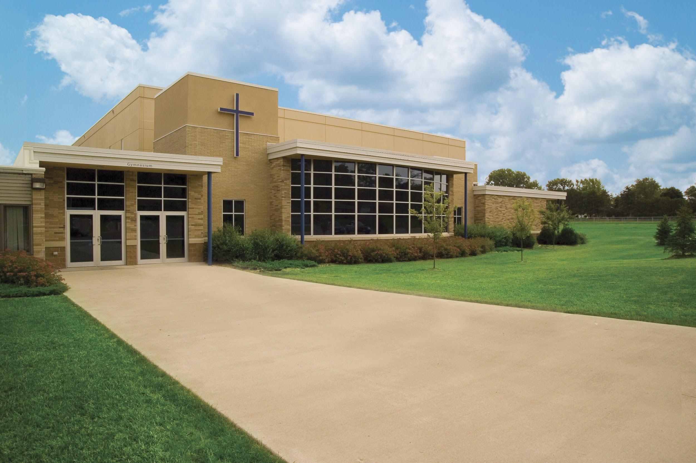
Closing
E³ = L²HS
Educate, Encourage, Equip
All thanks and praise to God!

