Slide 1
64th Biennial Convention of the
Wisconsin Evangelical Lutheran Synod

Slide 2
64th Biennial Convention of the
Wisconsin Evangelical Lutheran Synod
WELS Ministry of Christian Giving
Rev. Kurt Lueneburg
Notes:
See our report in BORAM, pp. 32-38.

Slide 3
Southeastern Wisconsin District Conference
Wisconsin Evangelical Lutheran Synod
WELS Ministry of Christian Giving
Rev. Kurt Lueneburg
Notes:
See our report in BORAM, pp. 32-38.

Slide 4
Western Wisconsin District Conference
Wisconsin Evangelical Lutheran Synod
WELS Ministry of Christian Giving
Rev. Kurt Lueneburg
Notes:
See our report in BORAM, pp. 32-38.

Slide 5
WELS Ministry of Christian Giving
Rev. Kurt Lueneburg
Notes:
See our report in BORAM, pp. 32-38.

Slide 6
Scriptural encouragement
“No weapon forged against you will prevail, and you will refute every tongue that accuses you. This is the heritage of the servants of the Lord, and this is their vindication from me,” declares the LORD (Isaiah 54:17).

Slide 7
Scriptural encouragement
Your statutes are my heritage forever; they are the joy of my heart (Psalm 119:111).
Notes:
What statutes of the LORD give me joy?
The holy law of God which shows our sin and our need for rescue. God’s law is right, true, and beneficial.
The precious good news of Jesus who, for the joy set before him, endured the cross and sat at God’s right hand.
The encouragement to rejoice in the Lord always – in every situation and in every action, attitude and word.

Slide 8
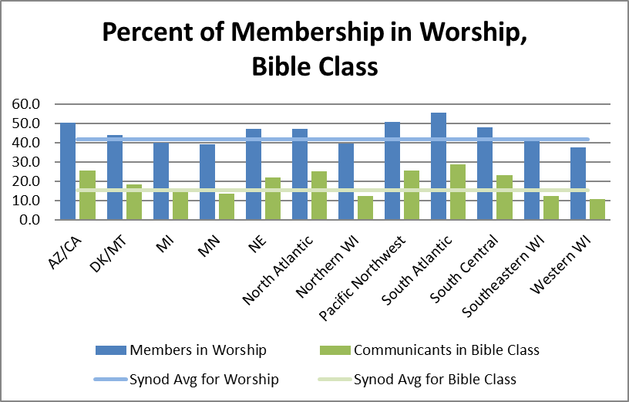
Worship and Bible study
41.7% in worship
15.2% in Bible class
2.5% of income to offerings
6.6% of church offerings given as CMO
Notes:
Note the fruit of those who rejoice in the Lord’s statutes! Average worship attendance in 2016 is down from 42.1% in 2015, and average Bible class attendance is down from 15.5% in 2015. Personal income to offerings stayed the same. Church offerings given as CMO is slightly down from 6.7% in 2015. (CMO + other gifts to WELS = 7.4%.) There’s room to grow in all these areas; let’s ask our gracious Savior to increase our love for his statutes!
2.5% income figure—based on WELS 2016 Statistical Report and the U.S. Dept. of Commerce Bureau of Economic Analysis (divided per communicant giving figure for synod by U.S. per capita income). 6.6% CMO figure—based on figures from WELS 2016 Statistical Report.

Slide 9
Congregation Mission Offerings
2016 offerings totaled $21.1 million
This was 0.3 percent below commitments and 2.1 percent below prior year receipts
2017 subscriptions show an increase of 0.8 percent from 2016 actual offerings
2017 offerings through May are $156,000 (2 percent) above 2016 CMO for the same period
We thank the Lord and his people for their gifts!
Notes:
We’re truly grateful to our heavenly Father for the wonderful thank offerings his congregations gave him in 2016 for his worldwide work through our church body--$21.1 million. We commend you for your part in encouraging and presenting such gifts! Christ’s gifts through his people continue to be strong in 2017. To him be the glory! We commend you for your thoughtful generosity!

Slide 10
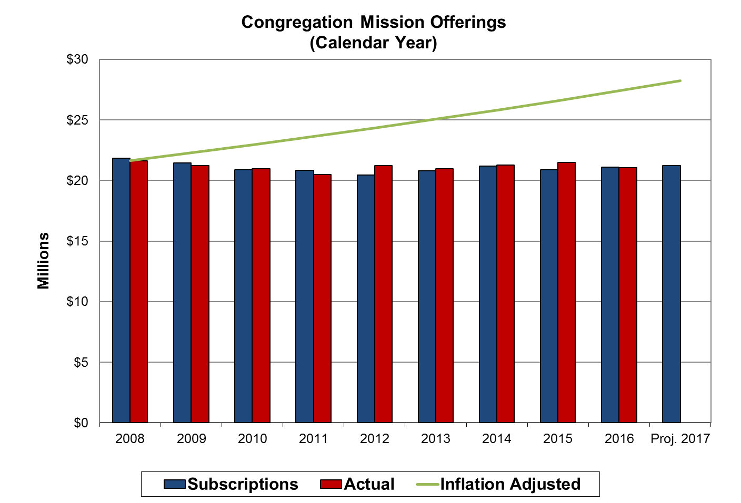
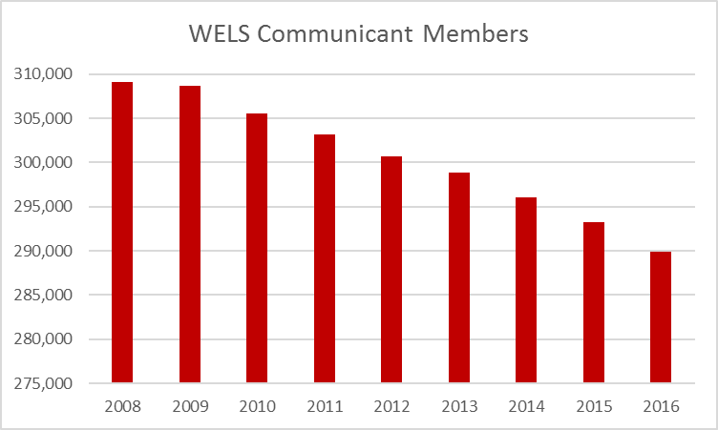
Congregation Mission Offerings
Year to year CMO have remained level.
Notes:
It is evident that God’s people through their congregations glorify God through their Congregation Mission Offerings. It’s remarkable when we consider the decline in our communicant population. As we acknowledge the Lord’s goodness to us, we also recognize that our CMO isn’t keeping up with the approximately 3.5% annual increase in the cost of maintaining our present level of ministry. Let us ask God for his blessings of contentment, trust, and generosity as we encourage growth in CMO and additional gifts from individuals.

Slide 11
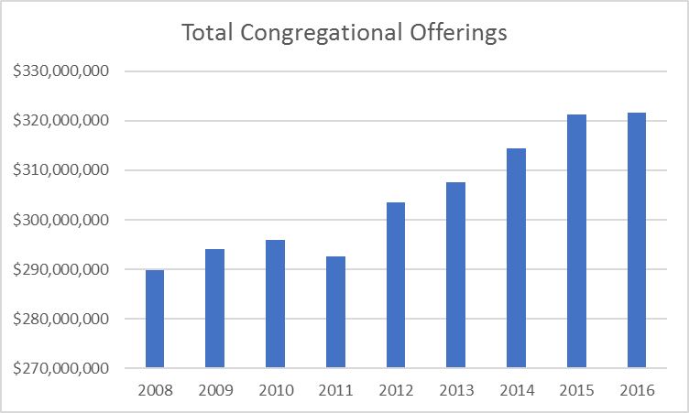
Congregation Mission Offerings
CMO remains level while total church offerings increased.

Slide 12
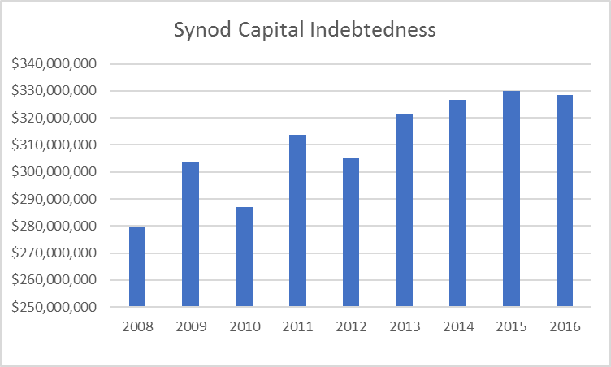
Congregation Mission Offerings
CMO remains level while capital indebtedness increased.

Slide 13
Congregation Mission Offerings
When setting CMO, aim for 10 percent of offerings. If at or above this goal, encourage your congregation to keep increasing.
“Excel in this grace of giving….For you know the grace of our Lord Jesus Christ” (2 Corinthians 8:7,9)
Notes:
When setting CMO, we encourage all our congregations to consider designating 10+percent of general offerings for CMO. The reason? Because you know the grace of our Lord Jesus Christ! Also, it’s the foundational source of synod support.

Slide 14
Congregation Mission Offerings
WELS Connection
Together e-newsletter
Forward in Christ
Annual Report
Annual CMO setting materials
Notes:
Please note these resources that are designed to keep you and others informed about how CMO and unrestricted IMO is being used to further Christ’s kingdom.

Slide 15
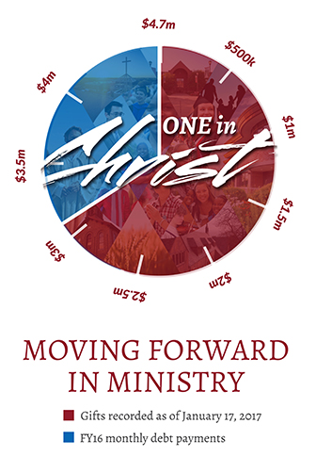
“One in Christ” Debt Elimination
Praise God - the effort to pay off our $4.7 million debt was successful!
From 7/1/15-1/1/17, 572 congregations and 2,273 individuals and other organizations gave $3.1 million.
$1.6 in payments from FY16 budget
Notes:
The “One in Christ” debt elimination offering has been wonderfully blessed by our Savior! We thank God for helping us eliminate $22.4 million in debt through payments and gifts in eight years! Join me in praising Jesus for the thousands of families whom he moved to participate in “OiC.” What a wonderful response to Christ’s love!
An additional $200,000 in FY17 synod payments helped cover campaign costs, municipals bonds’ closing costs, etc.

Slide 16
Individual offerings
Notes:
Note to Kurt: Link is embedded in image. Clicking the image will take you to the Vimeo page. You will have to click the play button and then the bottom-right x-arrows icon to go full screen. When you need to stop the video, hover toward bottom and hit pause button. Then hit x-arrows icon to minimize video. Click on PowerPoint app at bottom: Slideshow: From Current Slide.
(It might be beneficial to have a tech person onsite take care of the video portion of the presentation.)

Slide 17
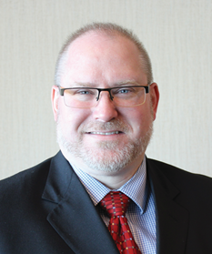
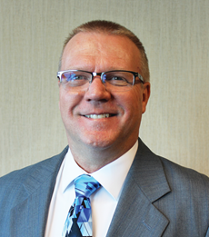
Individual offerings
Your giving counselors:
Rev. Kevin Hundley, Current Gifts
Phone: 262-237-2660
E-mail: kevin.hundley@wels.net
Mr. Rick Kneser, Deferred Gifts
Phone: 262-305-7688
E-mail: rick.kneser@wels.net
Notes:
Southeastern Wisconsin District

Slide 18
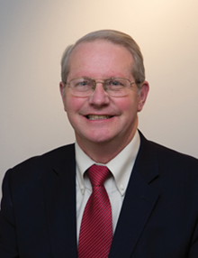
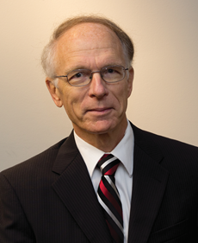
Individual offerings
Your giving counselors:
Rev. Steve Staude, Current Gifts
Phone: 262-706-5018
E-mail: steve.staude@wels.net
Mr. Gerry Heckmann, Deferred Gifts
Phone: 920-390-0741
E-mail: gerry.heckmann@wels.net
Notes:
Western Wisconsin District

Slide 19
Scriptural encouragement
Children are a heritage from the Lord, offspring a reward from him (Psalm 127:3).
Notes:
The children God gives us a precious heritage and gracious reward! We honor our Lord by bringing our children to Jesus in baptism, training them to grow in the grace of our Lord Jesus Christ during their lives, and stay faithful to Christ even to the point of death. As we prepare to transition to heaven, we do well to prepare estate plans that allow us to testify to our faith, provide powers of attorney if we become incapacitated, and provide for our loved ones and the Savior’s work as we distribute the wealth he’s given us.

Slide 20
Individual offerings
3 in 10
have a will
Notes:
There is a real opportunity to encourage free, confidential Christian estate planning through our MCG. Of every 10 Lutherans, 3 have a will of their own making. (The others die intestate and fall under the jurisdiction of their state’s laws.)

Slide 21
Individual offerings
1 in 3
remember a charity in their estate plan
Notes:
On average, of every three Lutherans who have a will of their own making, only one leaves a gift to the Lord for his work. Clearly, there’s significant room for growth in this area. WELS MCG is well-suited to assist since we offer free, confidential counsel.

Slide 22
Individual offerings
In fiscal year 2016–17 (through April), WELS Christian giving counselors (11.8 full-time equivalents) conducted 2,906 free, confidential visits with God’s people that helped facilitate $4 million in gifts received and $40.9 million in gifts expected for WELS.
Notes:
Jesus is blessing our service to his people and him! Through the first ten months of this fiscal year, our CGCs conducted over 2,900 visits that helped facilitate about $4 million in immediate gifts to WELS areas of ministry and $40.9 million in expected gifts for Christ’s work through WELS areas of ministry, your congregations, and regional ministries! (Not included are over $3 million in received expectancies.)

Slide 23
Individual offerings
New opportunity: the qualified charitable distribution
Those 70.5 or older can make tax-free gifts to ministry from their IRAs.
Consider directing required minimum distributions to ministry to save on taxes, then use the cash you would have given to charity for other needs.
Notes:
If you do not need the required minimum distributions that you receive from your IRA, consider directing those to WELS to save on taxes, then use the cash you would have given to charity for other needs. (There’s a $100,000 limit per IRA holder each year.)

Slide 24
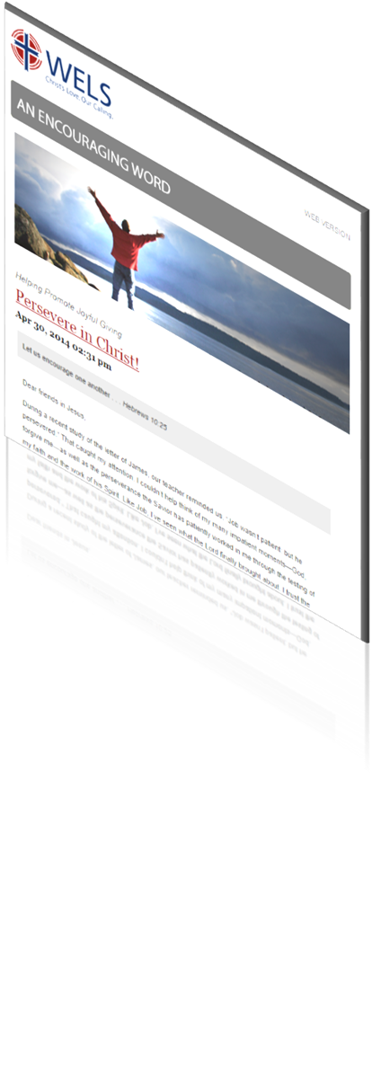
Resources
An Encouraging Word
Tips from those experienced in the area of stewardship
News and updates on resources
Prayers for synod ministry
“Stewardship by the lectionary” devotionals based on weekly readings; share God’s stewardship truths according to the pericope
Cut and paste planned giving articles
Notes:
We feel privileged to provide biblical resources for stewardship encouragement. For all of these resources go to Ministry of Christian Giving’s resource center on wels.net. To subscribe to Encouraging Word go to wels.net/subscribe.

Slide 25
Resources
Stewardship program: Joyful Generosity
Worship helps
Bible study
Personal devotions
Shares the Bible’s clear teachings on the management of our possessions
Notes:
This program was written by two MN District pastors, and is based on the WELS School of Stewardship materials (2008).

Slide 26
Resources
Congregational planned giving program
A guide for encouraging planned giving in your church using synod resources and the assistance of your local giving counselor
Includes “quick starts” to promoting planned giving and setting up an endowment as well as more complex options
Notes:
The congregational planned giving manual gives practical advice for regularly encouraging planned giving in your congregations and lists the free resources that are available to you. (It also explains how to set up a congregational endowment fund, whether doing this quickly and easily through WELS Foundation or administering your own.)

Slide 27
Mission and Ministry Sunday
WELS will provide worship, Bible study, and other resources to aid in traditional-style mission festivals.
This is a chance to recommit ourselves toward the Great Commission locally and through the opportunities God gives us as a synod.
Special offerings can go to a designation chosen by the congregation or to “WELS Mission and Ministry” to support our daily gospel work.

Slide 28
Scriptural encouragement
For you, God, have heard my vows; you have given me the heritage of those who fear your name (Psalm 61:5).
Notes:
As we express our praise and thanks in tangible resolutions – both here and when we return to our vocations and congregations – we may be confident in Christ that God hears us and will bless us to his glory, our good, and the benefit of souls around the world!

Slide 29
Thank you!
WELS Ministry of Christian Giving
mcg@wels.net
800-827-5482
Notes:
Thank you for your time today and your partnership in Christ’s kingdom. The grace of the Lord Jesus be with you!
Please visit the displays of WELS Foundation/WIF and MCG.

