Slide 1

Western Wisconsin District
June 6, 2017
Notes:
Thank you for the opportunity to share an update on the ministry of Northwestern Publishing House. What a privilege it is for us at NPH to partner with you in serving God’s people through your public gospel ministry and the work you are doing in the classroom.

Slide 2

“Let the word of Christ
dwell in you richly.”
Colossians 3:16
Notes:
NPH continues to work hard to develop resources that we pray will provide a benefit to those we serve. You have received a print out of the resources NPH has recently produced. I hope you will look over that handout for materials that will help you and your congregations grow in your Christian life. Our goal is to produce Christ centered materials that will do just that. Note the coupon on the first page. Since you received this hand-out I did not want to rehearse everything contained in it but simply call your attention to what is available and especially call your attention to the coupon which you can use either in person at the retail store or on-line. If you go on-line, you will notice that there is a new look to our on-line shopping. We think you will find it easier to use and invite you to use the website often.
We have been richly blessed to be able to serve you and your members with these Christian resources.
What I want to accomplish today is to highlight some of the Reformation materials that can help you celebrate the 500th anniversary of the Reformation.

Slide 3

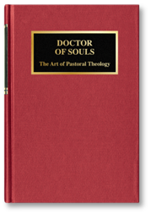
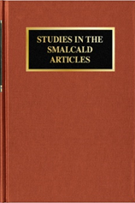
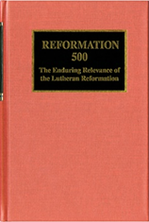
What’s New from NPH?
Notes:
For our Pastors NPH publishes Bible commentaries and various books on Christian doctrine, pastoral theology, and church history. We have recently introduced:
Studies in the Smalcald Articles. This book has been updated using a contemporary translation and reissued. This is a significant study on Luther’s last will and testament created at the juncture of the formation of the Smalcald League when the Lutherans were called to defend their faith and their territories against the theat of military action by the Catholis
Reformation 55: The Enduring Relevance of the Lutheran Reformation: Essays by WELS scholars on the Lutheran Refermation. A book commemorating the 500th anniversary of the Reformation
Doctor of Souls: The Art of Pastoral Theology A new text on pastoral theology written by Prof. John Schuetze of WLS

Slide 4

What’s New from NPH?
A New Exposition of Luther’s Catechism
Two versions: NIV and ESV
All New Exposition (51 Lessons)
Color Coded
Familiar Diagrams Revised
New “Connections” Section for each lesson
  Bible history related to each lesson
  Luther quote
  Hymn verses
Can be used for Family and Individual Devotions
A Lifelong Resource for God’s People
Notes:
A New Exposition of Luther’s Small Catechism
Gausewitz Catechism: 1956
Kuske Catechism: 1982 (Revisions: 1989 and 1998)
Anniversary Catechism 2017
Smaller Size
Readibility; eash to follow and read through
Diagrams are revisited and updated where necessary
Color added: Each chief part (bleed to easily go to a section)
Connections: Foster Lutheran heritage
Life-long use
Devotional approach for family and indibiduals
Hymns: consistent with new Lutheran hymnal
Appendices: Index, Scripture passages, glossary
51 unites
Explanations Sections
Two versions: NIV and ESV

Slide 5
What’s New from NPH?
Digital Diagrams for the Teacher
Notes:
Diagrams available electronically for classroom use

Slide 6
What’s New from NPH?
A New Approach for Students
A Book for Student Notes
Questions without answers for all 51 Lessons
Space for Memory Work
Diagrams and space for notations
Space for answers and notes for each “Connections” Section
  Bible history exercise and questions
Allow Pastors to choose any translation for memory work assignments.
A place for personal notes from Instructions for reference and review
Notes:
A companion for students to use
Questions without answers for all 51 lessons; room for notes
Space for assigned memory work; writing it out as a aid to memory work
Space to complete “Connections” sections

Slide 7

What’s New from NPH?
A New Translation of the New Testament and Psalms
Evangelical Heritage Version
(EHV)
Notes:
Thanks to the Wartburg Project for all their efforts.
We are also working with them on the Old Testament.

Slide 8

What’s New from NPH?
Reformation 500
Resources for Congregations and Schools
Notes:
Concentration today on Reformation Resources
Goals of the Reformation 500 committee:
1. Provide resources for congregations to use to educate members about the truths God allowed Luther to recover.
2. Provide resources for congregations to reach out with the gospel

Slide 9
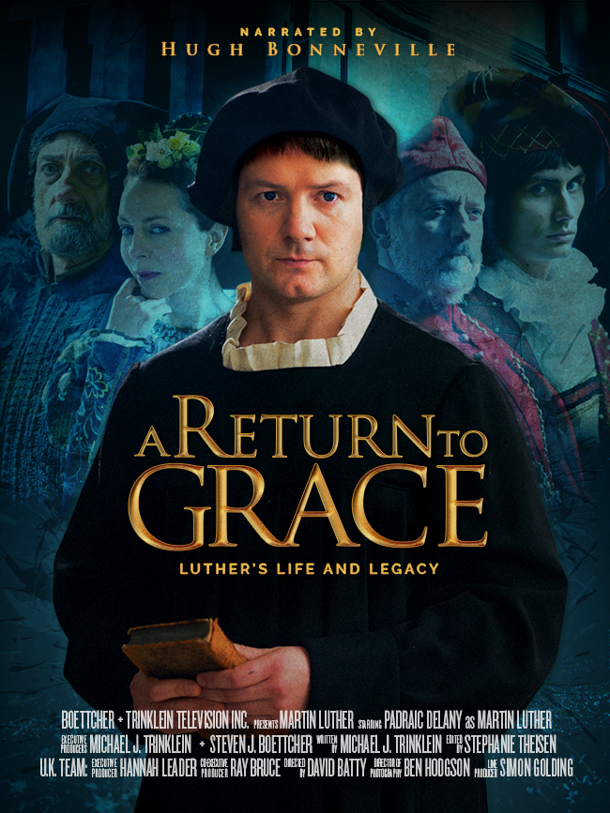
A Return to Grace
Show the new Luther movie at a local movie theater.
Education for Congregation
Outreach for Prospects
wels.newluthermovie.com
Notes:
New Luther movie
1. Educate: See the movie Tugg The theater experience will be an important event for your congregation and provide opportunity for outreach.
2. Movie will be available in Fall on DVD

Slide 10
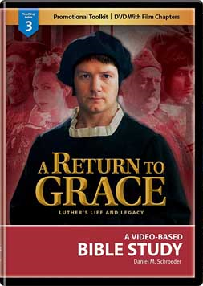
A Return to Grace Resources
Available now
Four Lesson Bible Study with 10 Minute Video Clips
DVD Available in Fall
Notes:
Bible Study based on the Film
Four lessons with 10 minutes video clips 1 for each lesson. Full Film is not included
1. Grace Hidden
2. Grace Rediscovered
3. Grace Defended
4. Grace Confessed and Enduring

Slide 11
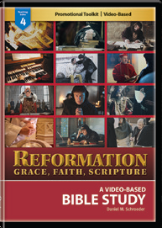
Reformation: Grace, Faith, Scripture
Available now
An Adaptable Resource
Includes:
12 Vignettes (3-4 minutes)
A Short Bible Study on each vignette
A Longer Bible Study on each vignette
Digital Bulletin inserts (color and grayscale)
Promotional Tool Kit
Separate DVD with only Vignettes Available
Notes:
An adaptable Resource
12 Vignettes (3-4 minutes each)
Baptism
Justification by Faith
Forgiveness in Christ Alone
Holy Communion
Saint and Sinner
Augsburg Confession
Congregational Worship
Vocation
Scripture Alone
Confidence from the Scripture
Power of the Word
The Bible in People’s hands
Three approaches
1. A Short Bible Study (15 minutes)
2. A Longer Bible Study (45 minutes)
3. Vignettes Separately for showing in church or at organizational meetings
Promotional Tools including bulletin inserts to announce and to help viewers focus on the issues

Slide 12
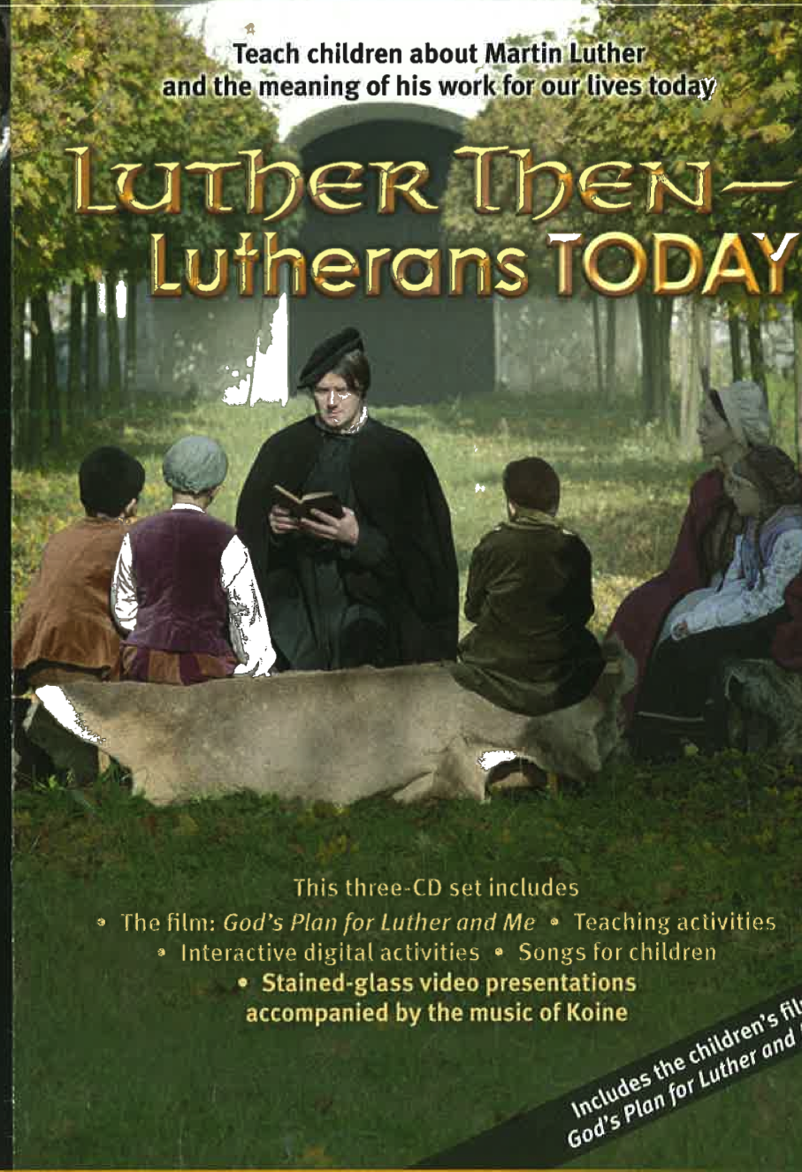
Luther Then—Lutherans Today
A Resource For Children
Includes:
A 25 Minutes Film on Luther’s Life
  God’s Plan for Luther and Me
Classroom Activities (Two levels)
Songs for children
Stained-glass video presentations accompanied by the music of Koine
Interactive Digital Activities
God’s Plan for Luther and Me Film Available Separately Without Resources
Available This Summer
Notes:
A resource for children
25 minute Film with classroom activities
Children’s songs

Slide 13
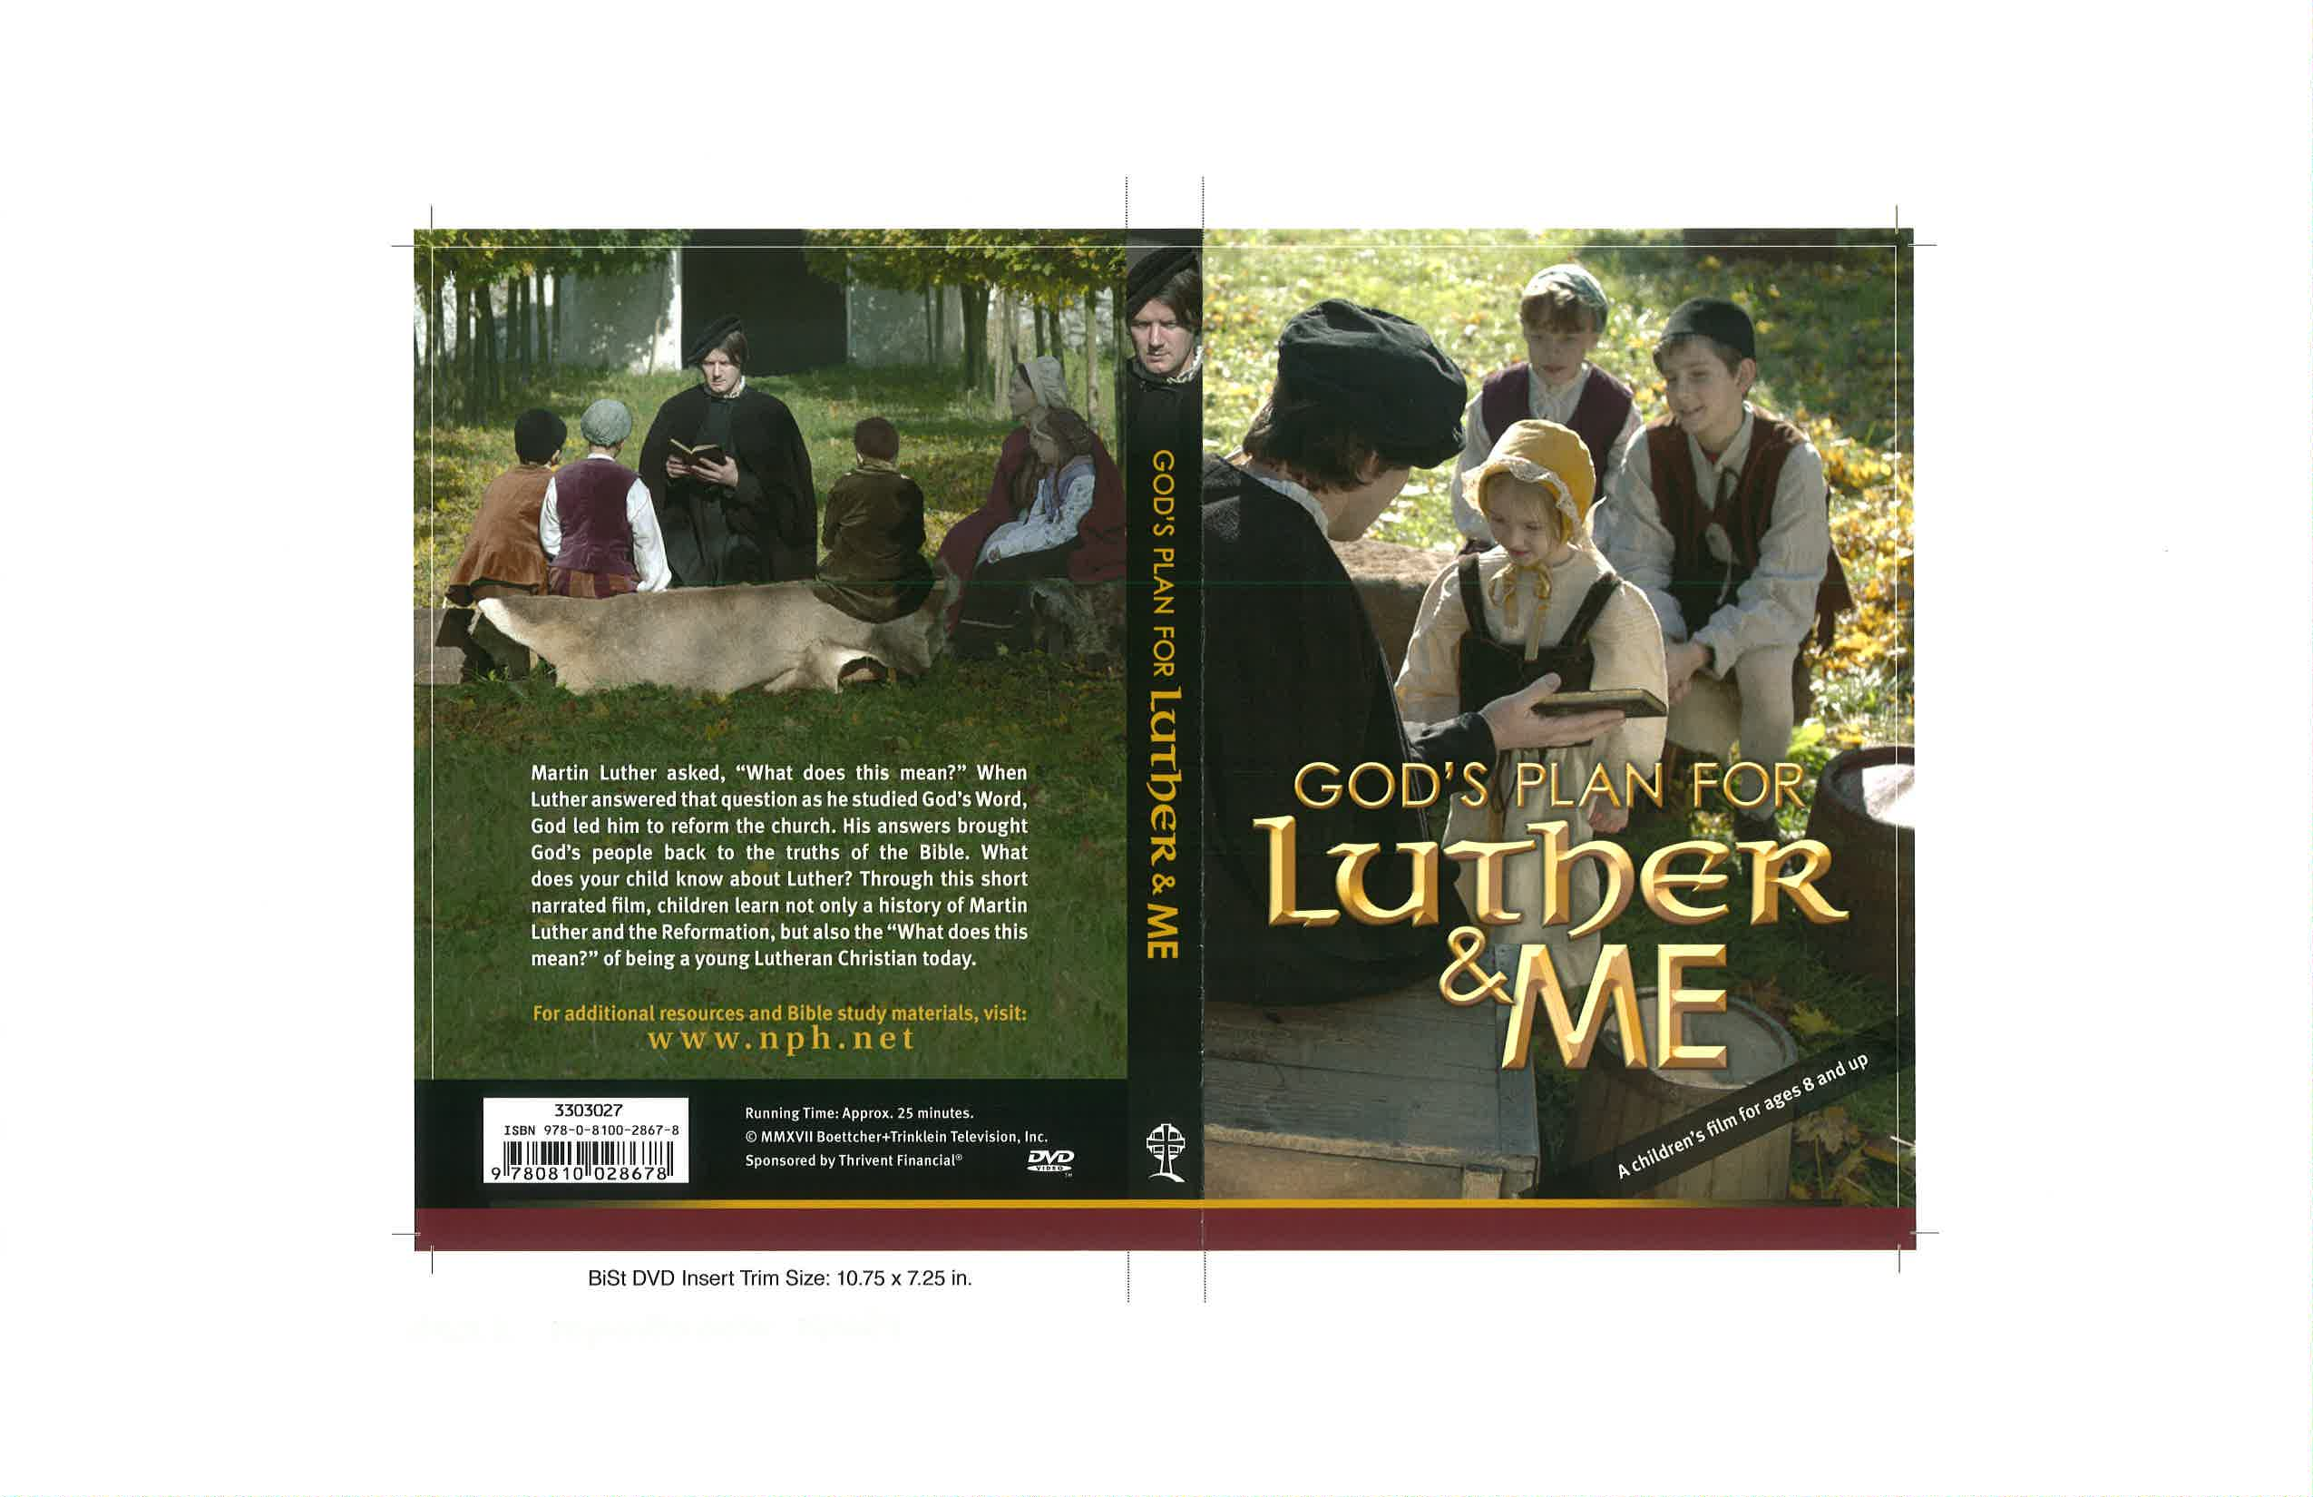
Separate DVD for Children
Available This Summer
Notes:
The children’s version of the Luther film available separately
25 minutes in length.

Slide 14
Resources For Outreach
Four Sunday Emphasis
  November 5, 2017: Scripture Alone
  November 26, 2017: Christ Alone
  December 17, 2017: Grace Alone
  January 7, 2018: Faith Alone
Opportunity and encouragement for members to invite friends and relatives.
Opportunity to invite prospects and neighbors.
Special Worship resources friendly to visitors for each Sunday.
Sermon Resources for each Sunday.
Promotion, Invitation, and follow-up materials.
Adaptable for individual congregation’s use and schedule.
Developed by Commission on Evangelism and Home Missions.
Resources: download free at
wels.net/reformation500
Notes:
Outreach possibilities
Evangelism (M. Hintz)\
Home Missions (K. Free)
Suggested Sundays can be altered for specific local congregational needs

Slide 15
Special Reformation Bulletin
Notes:
Special Reformation Bulletin
Available from NPH
Adaptable; designed for use in Outreach efforts or congregational or regional/district worship services.

Slide 16
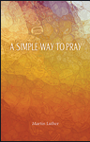
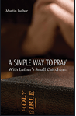
Additional Resources
Notes:
Luther’s A Simple Way to Pray
two versions
Text
Text with Luthers Enchiridion (Small Catechism)
Can be used as give away to prospects attending outreach services (quantity discounts)

Slide 17
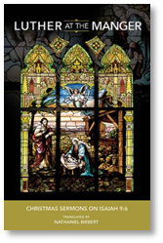
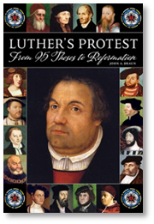
Additional Resources
Notes:
Two new books
Luther at the Manger: New translation of Luther’s Christmas sermons set up for Advent/Christmas devotions
Luther’s Protest: Biography of Luther and history of the reformation

Slide 18
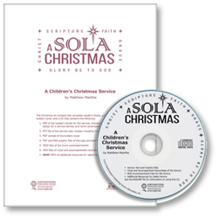
Additional Resources
Notes:
A Children’s Christmas Kig: Christmas 2017

Slide 19
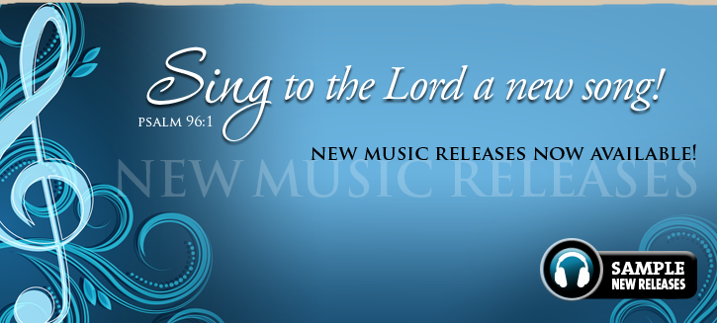




Please Support Our Ministry
Notes:
The ministry of Northwestern Publishing House is solely funded by sales of the materials we offer. Our support therefore comes from you and those in your church and school. We rely on you, pastors and teachers, to help us get the word out about NPH and what we offer. Please support our ministry:
Please make your church members and parents aware of the resources we have for them by sharing NPH information materials that are sent to your church or school
Host an NPH Book Fair to bring the NPH bookstore to your church or school
Like NPH on Facebook individually, as a church, or as a school to receive daily devotions, inspiration, news, and more
And encourage your members and school parents to join the NPH EXTRA rewards program to give back to their church or school with every purchase they make
THANK YOU again for your time and the opportunity to provide an update on the ministry of Northwestern Publishing House!

Slide 20

God’s Word for My Life

